Slide 1
Topic 10 Unsteady-Flow Processes
Thermodynamics: An Engineering Approach
8th Edition Yunus A. Çengel, Michael A. Boles
McGraw-Hill, 2015

Slide 2
Objectives
Apply the energy balance to general unsteady-flow processes with particular emphasis on the uniform-flow process as the model for commonly encountered charging and discharging processes.

Slide 3
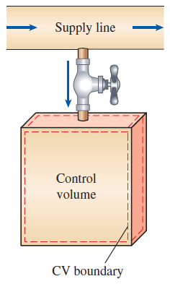
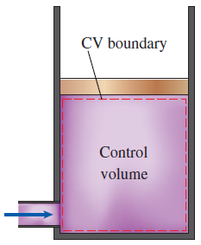
ENERGY ANALYSIS OF UNSTEADY-FLOW PROCESSES
Many processes of interest, involve changes within the control volume with time. Such processes are called unsteady-flow, or transient-flow, processes.
Most unsteady-flow processes can be represented reasonably well by the uniform-flow process.
Uniform-flow process: The fluid flow at any inlet or exit is uniform and steady, and thus the fluid properties do not change with time or position over the cross section of an inlet or exit. If they do, they are averaged and treated as constants for the entire process.
Charging of a rigid tank from a supply line is an unsteady-flow process since it involves changes within the control volume.
The shape and size of a control volume may change during an unsteady-flow process.

Slide 4

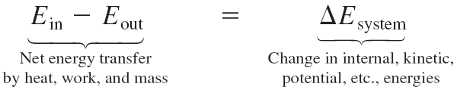


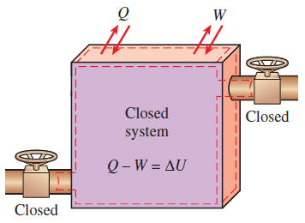
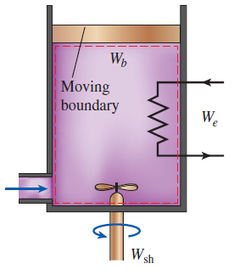
Mass balance
Energy balance
A uniform-flow system may involve electrical, shaft, and boundary work all at once.
The energy equation of a uniform-flow system reduces to that of a closed system when all the inlets and exits are closed.

Slide 5
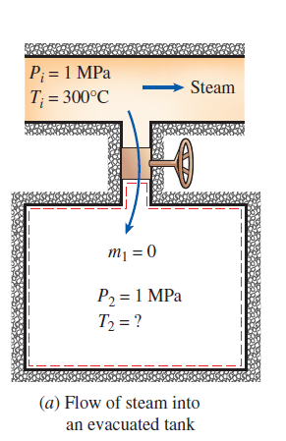
Charging of a Rigid Tank by Steam
A rigid, insulated tank that is initially evacuated is connected through a valve to a supply line that carries steam at 1 MPa and 300ºC. Now the valve is opened, and steam is allowed to flow slowly into the tank until the pressure reaches 1 MPa, at which point the valve is closed. Determine the temperature of the steam in the tank.
Solution

Slide 6
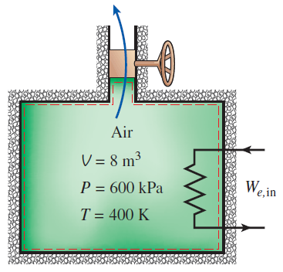
Discharge of Heated Air at Constant Temperature
An insulated 8 m³ rigid tank contains air at 600 kPa and 400K. A valve connected to the tank is now opened, and air is allowed to escape until the pressure inside drops to 200 kPa. The air temperature during the process is maintained constant by an electric resistance heater placed in the tank. Determine the electrical energy supplied to the air during this process.
Solution

Slide 7
Summary
Energy analysis of unsteady-flow processes

